Slide 1
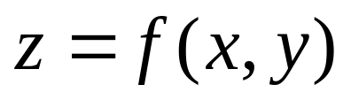
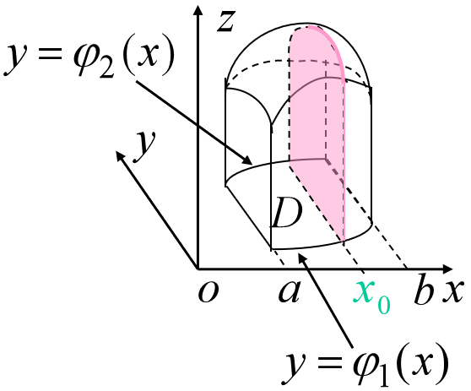
15.3-1 Calculation of double integrals
Find the volume of the solid under the surface
over the region D on the xoy plane

Slide 2
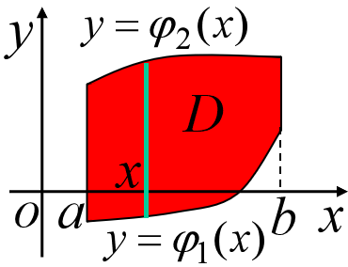
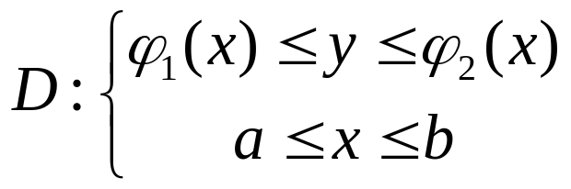

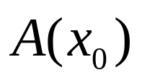
If the region of integration D is i X – type
First slice the solid at by a plane perpenducular to x
axis, the area of cross section at is

Slide 3











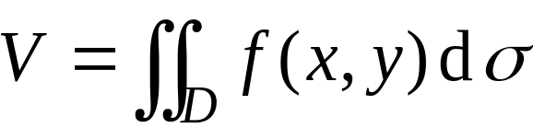
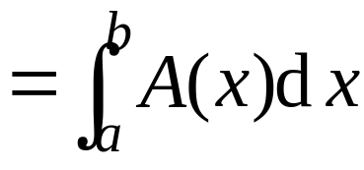
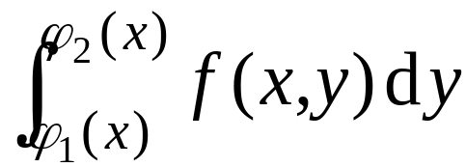
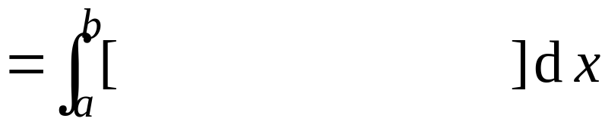
then the volume of the solid is

Slide 4




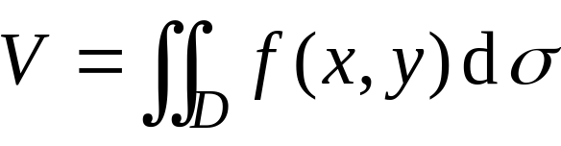

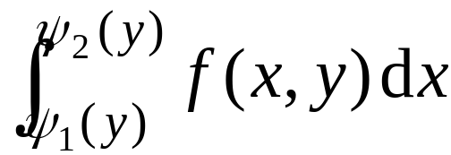


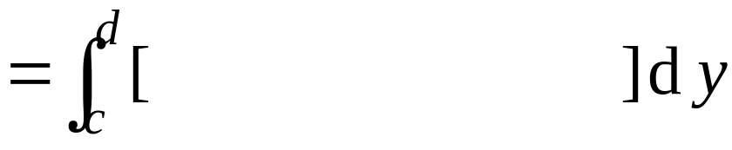
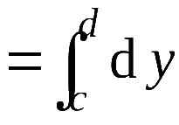
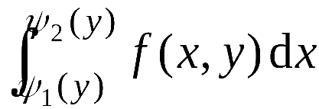

Similarly, if the region of integration D is Y-type
then the volume of the solid is

Slide 5


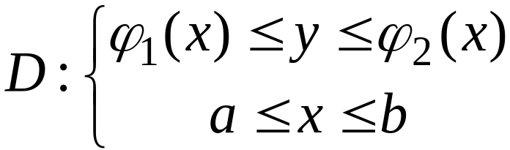




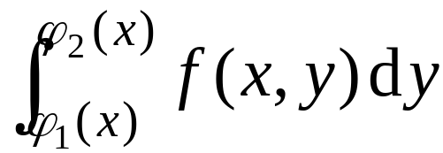

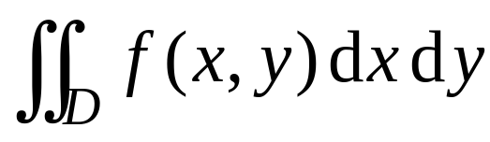
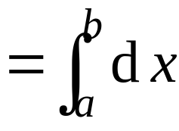

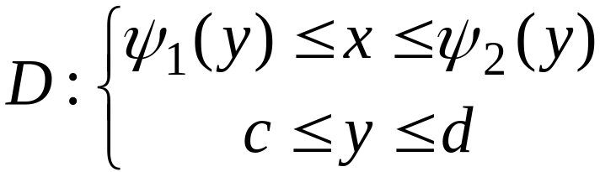




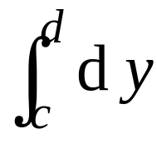
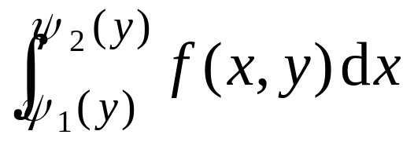
From the calculation of volume of the solid, we
know that if is continuous on D, and
if D is X – type region
then
if D is Y –type region
then

Slide 6

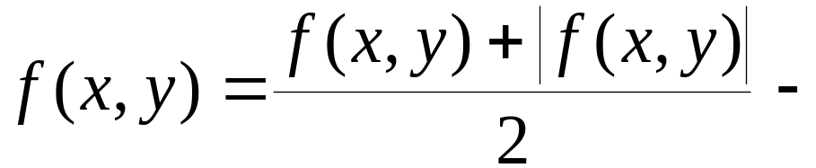
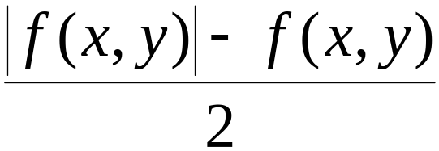




For a general function , since
we can also use iterated integrals to calculate double integrals .

Slide 7






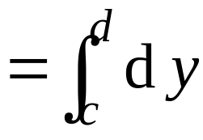



Remark: (1) If D is X–type region and alsoY –type
region, then
We can choose suitable order of iterated integral to calculate double integral, and sometimes we need to interchange the order of iterated integrals.

Slide 8
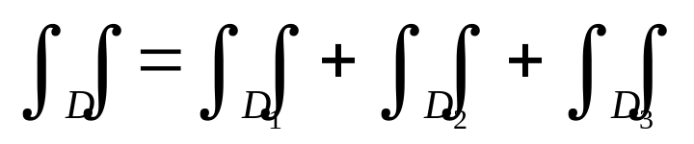
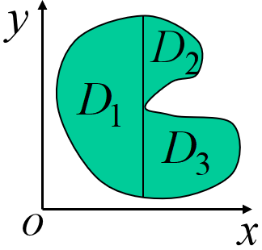
(2) For complicated region of integration D, we can partition D into X-type and Y-type regions, then by additivity,

Slide 9
Procedure of calculate the double integrals
1. Draw the figure of region of integration
2. Represent the region in X-type or Y-type
3. Tranform the double integral into iterated integrals:
X-type: First integrate w.r.t. y, then x;
Y-type: First integrate w.r.t. x, then y;

Slide 10

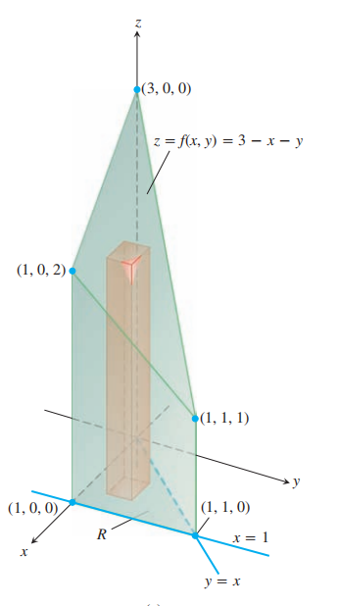

Slide 12


Slide 13


Slide 14
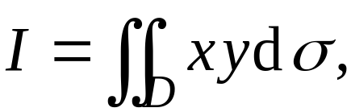
Example 4：Find
where D is the region enclosed by y＝1, x＝2, and
y＝x

Slide 16
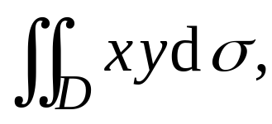




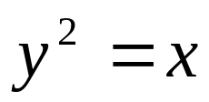

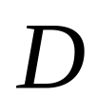





Example 5: Find
where D is the region enclosed by the parabola
and the line

Slide 18
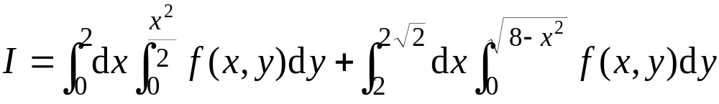
Example 6: Reverse the order of iterated integrals

Slide 19

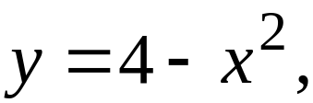




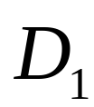






Example 7: Find
where D is enclosed by and

Slide 20

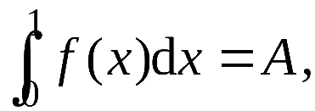



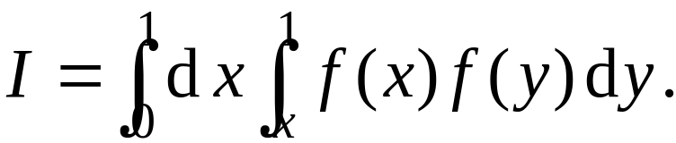



Exercise:
1. If
and
find

